Slide 1
Analysis of Global Education Indicators

Slide 2
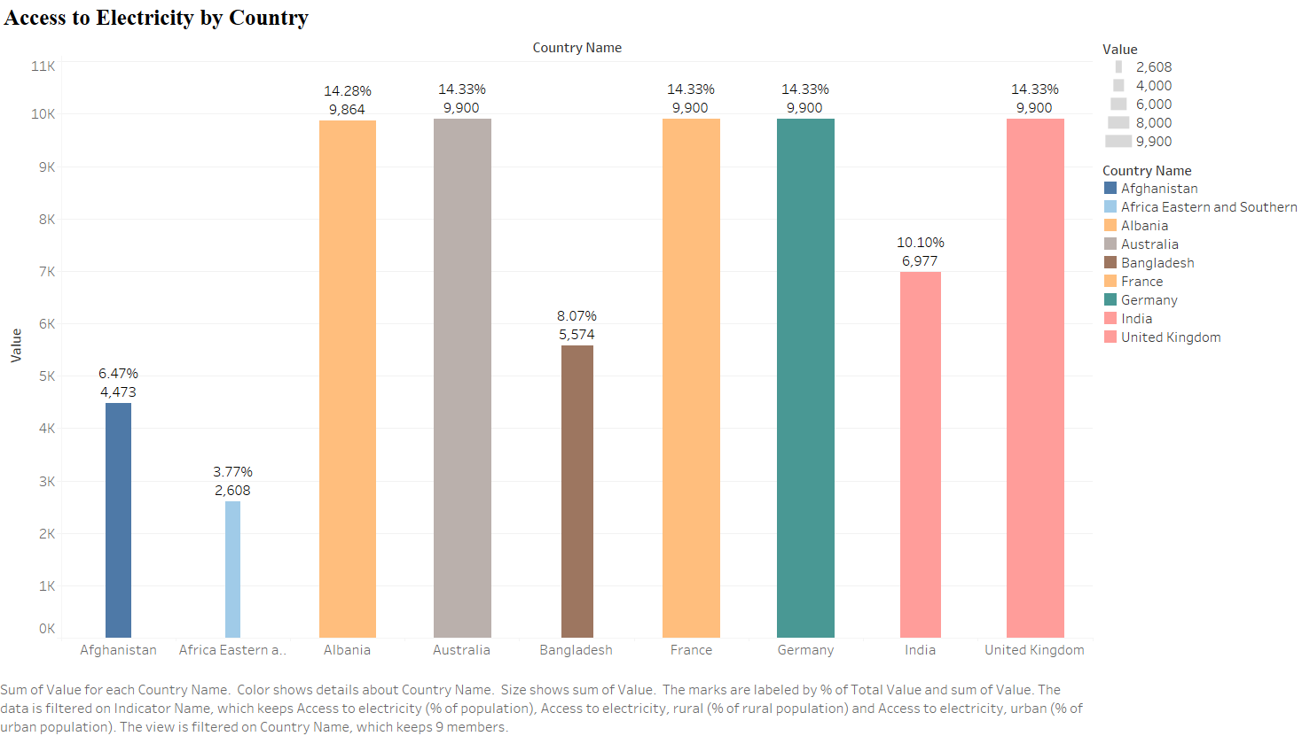

Slide 3
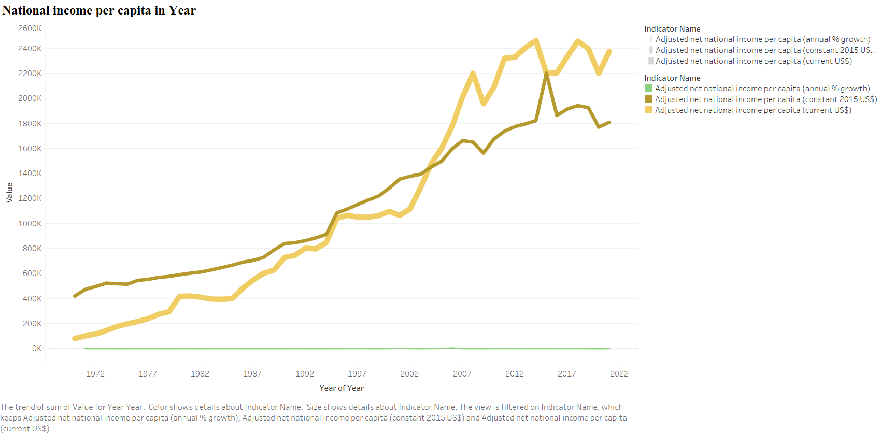

Slide 4
